Slide 1

Cloud architecture group project
McDonald’s
GROUP 4
PADCHA SAGAR

Slide 2
OBJECTIVES
What is it now???
Global Company storing data on-premise
Big daily data
Different location of data collection
No access to real-time data
What would it be???
Cloud data storage
Save cost and more secure
On-demand Storage
Real-time data monitoring for all locations

Slide 3

PLANNING DIAGRAM
Application and Website
Visitor Tracking
Managerial
Order – Online
Application/Website
Accounting
Order – Local Stores
Marketing
Cloud
Regions and Currencies
I.T.
On-Premise Data
HR
Delivery
(Local Store)
Inventory
(Suppliers and buyers)

Slide 4
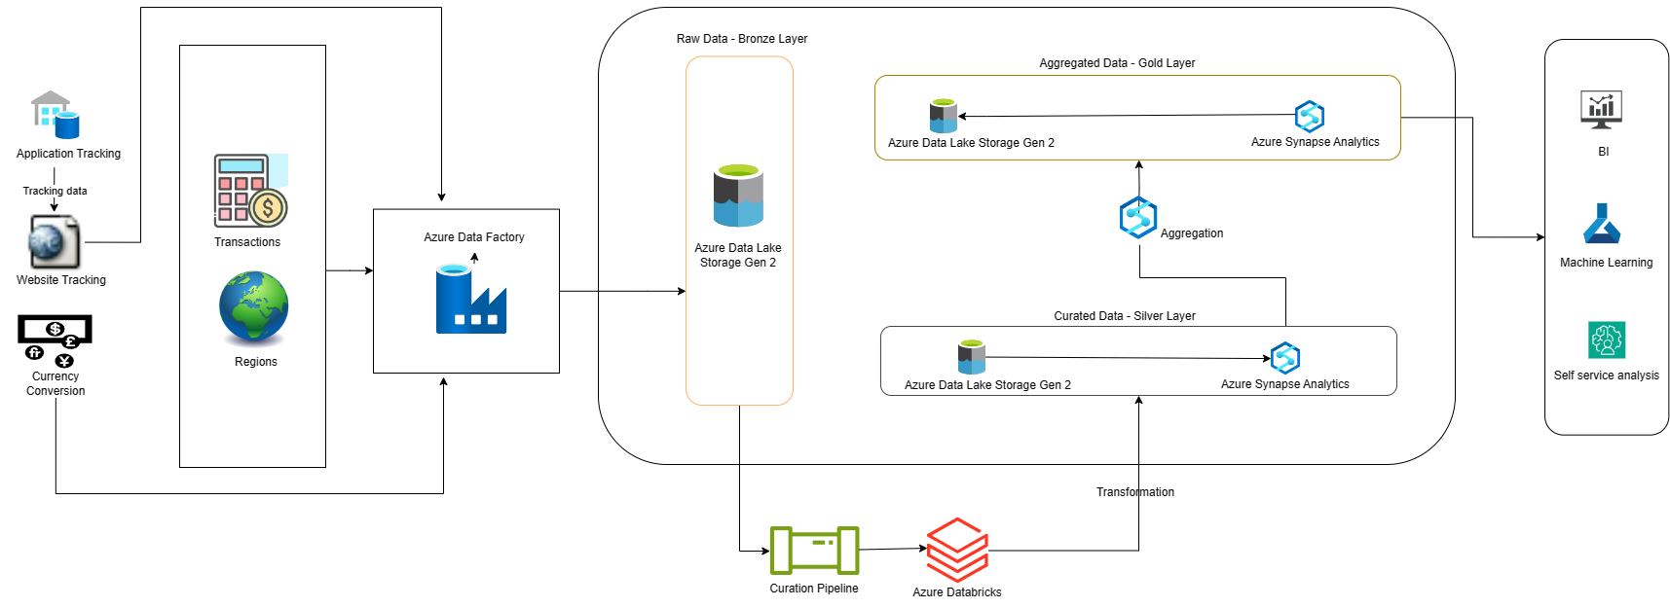
DATA ARCHITECTURE

Slide 5



PIPELINE COMPONENTS
SOURCES
INGESTION
TRANSFORMATION

Slide 6
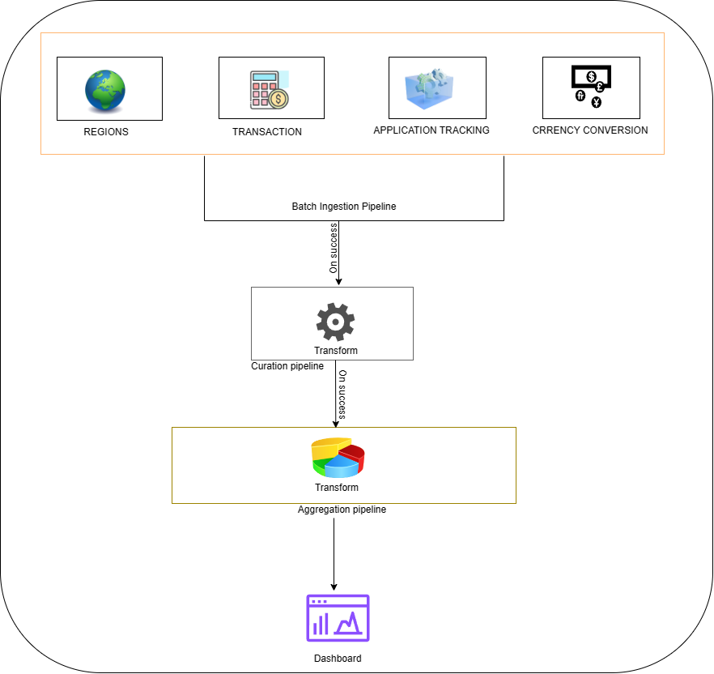
PIPELINE OVERVIEW

Slide 7
DATA SOURCE
Digital Interaction Data
Point-of-Sale Systems (POS)
Customer Feedback Systems
Marketing and Promotions Data

Slide 8
INGESTION MODE
Batch Ingestion
Why Batch Ingestion?
Effectiveness for Consistent Data
Decreased Use of Resources
Streamlined Data Integrity Development and Management

Slide 9


Deployment Strategy
Infrastructure as Code (IaC)
Azure Resource Manager (ARM) templates (JSON files)
CI/CD (Continuous Integration and Continuous
Delivery/Deployment)
Testing and deployment are automated.

Slide 10
Workflow
Pre-define Schedule
Update
Events
Notification
6AM
Daily
Low Stock
Pick up/Delivery Order Received

Slide 11
Pipeline Monitoring Strategy
Monitoring Tool
Key Metrics to Monitor
Azure Data Factory’s built in monitoring resources
Pipeline execution running status
Execution time
Data processing Time
Notifications

Slide 12

Development Method
Development Language
Python
Tools
Azure Data Factory

Slide 13
Thanks!

Slide 14
Contributions
Padcha – 50%
Sagar – 50%

